Slide 1
JavaScript Functions, Objects, and Output
SEWD
Bradley Perkins

Slide 2
Definition / Purpose
                Functions : A JavaScript function is a reusable block of code designed to preform a particular task, often accepting input values and returning an output value.
                Objects : A JavaScript object is a standalone entity that holds related data and functionality typically consisting of various unordered properties and methods
                Output : In JavaScript, output refers to the way a program displays data to the user or console, commonly achieved using methods like console.log() for debugging the document object model to update a web page.

Slide 3
Key Terms & Elements
Functions : Declaration/Definition, Invocation/Call, Parameters, Arguments, scope
Objects : Property, Method, Dot Notation, Bracket, Notation, Constructor
Output : Console.log(), DOM Manipulation, alert(), document.write()

Slide 4
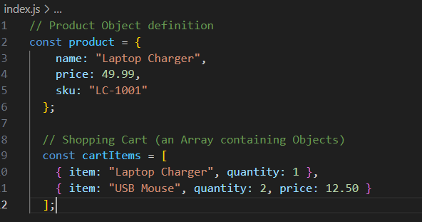
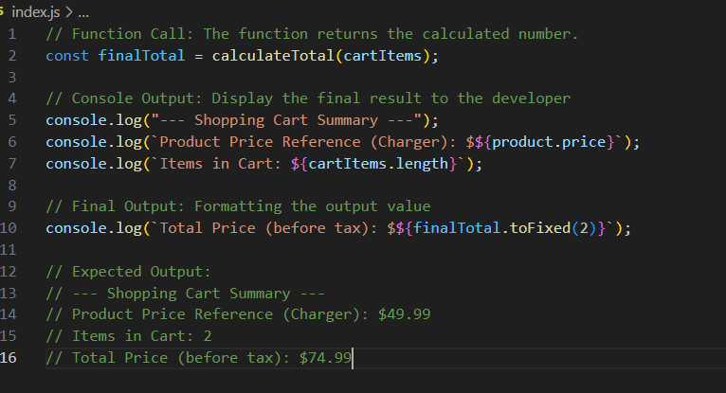
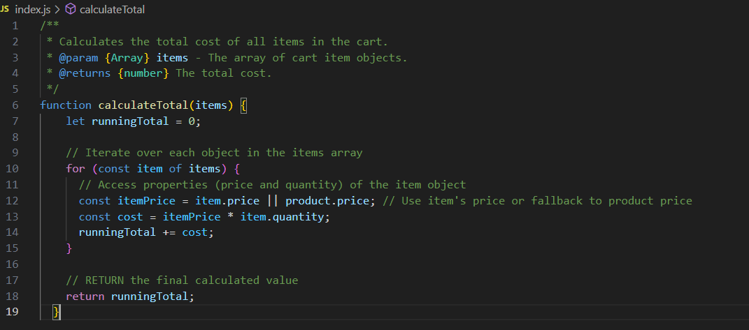
Visual example/ code snippet
Objects :
Functions :
Output :

Slide 5
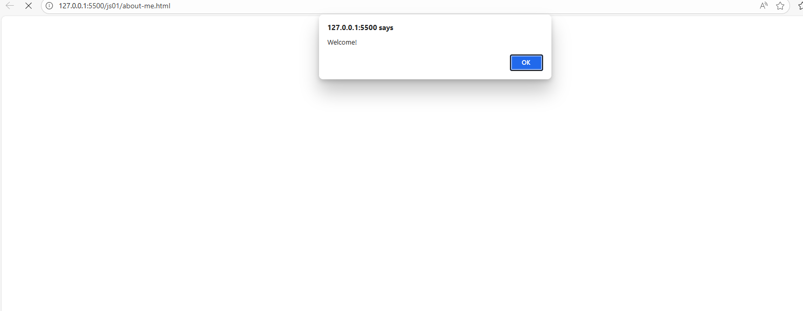
Applied example

Slide 6
Common mistakes/ tips
Mistake : Forgetting the return keyword in a function means the function returns undefined. Tips : Always use return when you need to send a value back to the code that called it.
Mistake : trying to access a property on an object this is null or undefined, which gives you an error. Tips : Use the optional chaining operator when accessing nested properties to prevent errors by returning undefined if any part of the path is null or undefined.
Mistake : Confusing console.log() with return, where developers expect the value printed to the console to be available to the rest of the program. Tips : Understand that console.log() is only for debugging output in the console, while return is the mechanism for a function to produce a usable result for other code.

Slide 7
Key takeaways
Functions are Reusable code blocks : They are the fundamental way to organize and reuse code by enclose a set of statements to preform a specific task.
Objects store collections of properties, Objects are JavaScript’s primary complex data type, used to store collections of key value pairs called properties.
Return vs. console.log() : Return defines the actual result of a function for program flow, while console.log is a utility primarily for debugging and displaying info in the console.

